Slide 1
REDUX
By Dmytro Minochkin

Slide 2
PLAN
Redux Intro
Redux Basics
Redux with UI
How to do async?
History and Principles of Redux
Actions and Reducers, Redux API
Redux with React
Redux Middleware and Side Effects

Slide 3
REDUX INTRO

Slide 4
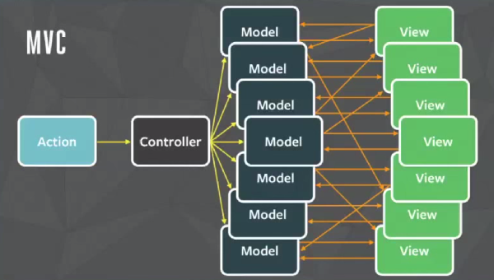
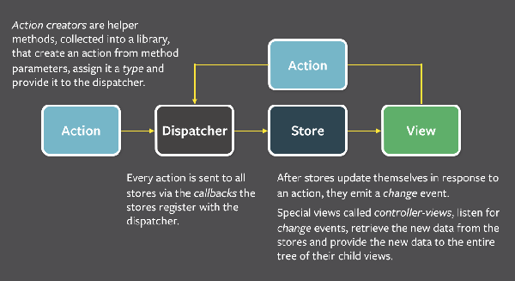
REDUX'S PREDECESSOR: FLUX
A year after releasing React, Facebook announced the "Flux Architecture”
"Flux is more of a pattern than a framework”
Basic concepts
Many data stores register with a singleton dispatcher.
To trigger updates, plain object actions are dispatched, and stores update themselves in response.
UI subscribes to stores, reads data on change events.

Slide 5
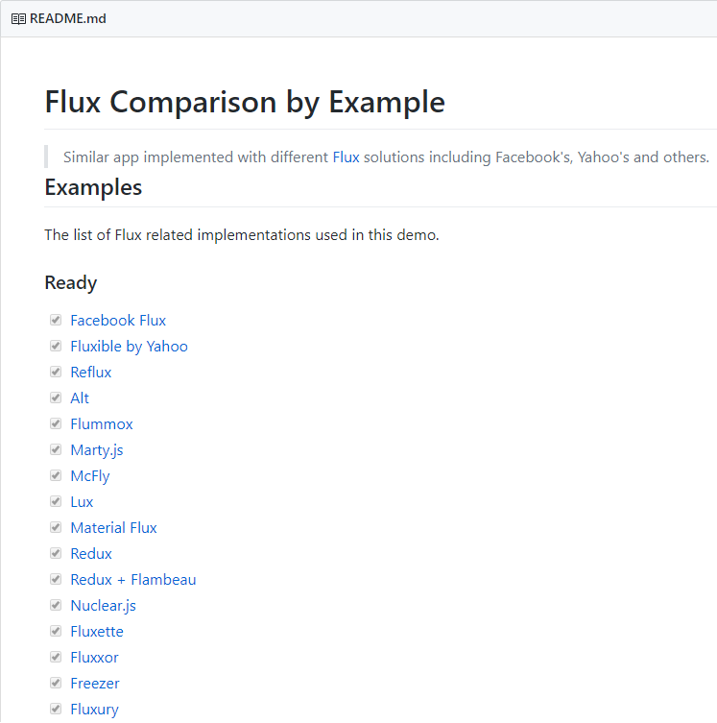
FLUX LIBRARIES
We had a pattern, but didn’t know how to do it right
Everyone in JS community tried to create the better flux
There are 20+ different libraries

Slide 6
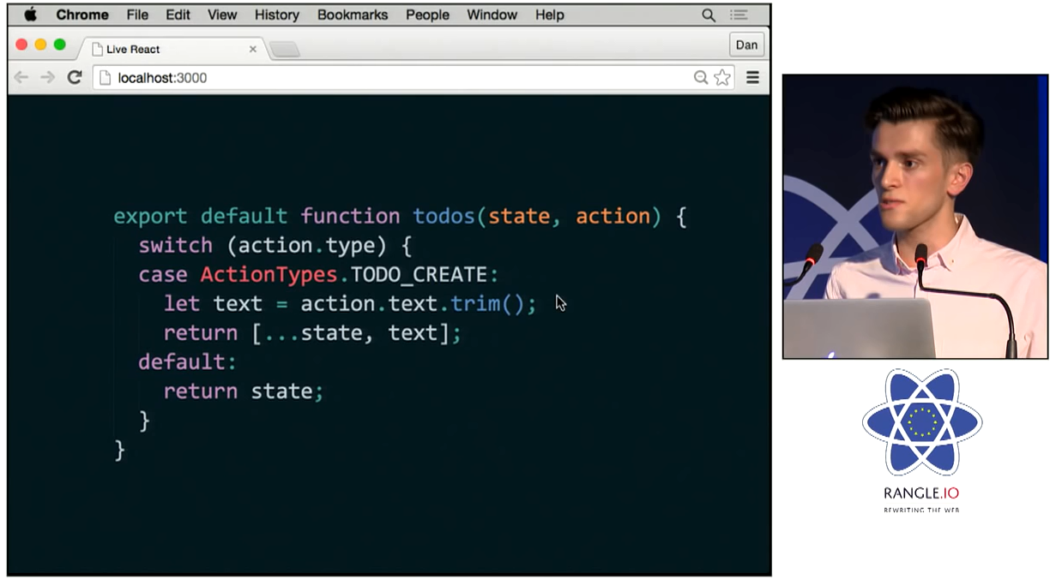
BIRTH OF REDUX
Created by Dan Abramov for a talk at React Europe 2015 to demonstrate the idea of "time-travel debugging".
Now the most widely used state management tool for React apps

Slide 7
WHAT IS REDUX?
Predictable
Redux attempts to make state mutations predictable by imposing certain restrictions on how and when updates can happen.
These restrictions are reflected in the three principles of Redux:
Single source of truth: The state of your whole application is stored as a tree of plain objects and arrays within a single store. (How much you put in the store is up to you - not all data needs to live there.)
State is read-only: State updates are caused by dispatching an action, which is a plain object describing what happened. The rest of the app is not allowed to modify the state tree directly.
Changes are made with pure functions: All state updates are performed by pure functions called reducers, which are (state, action) => newState
Centralized
Having a single store and single state tree enables many powerful techniques: logging of all updates, API handling, undo/redo, state persistence, "time-travel debugging", error reports with full snapshots of app state, and more.

Slide 8


Slide 9
REDUX BASICS

Slide 10
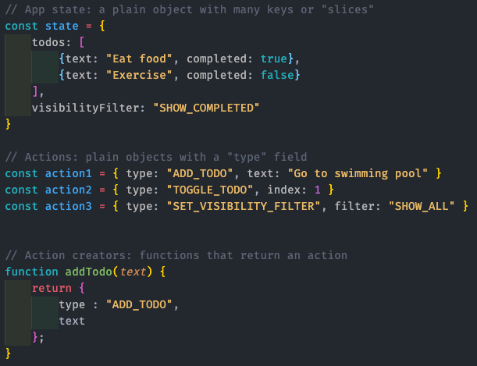
CORE CONCEPTS: ACTIONS
State
App state is stored in plain objects, like this Todo example.
There's no "setters", so that different parts of the code can’t change the state arbitrarily.
That helps avoid hard-to-reproduce bugs.
Actions
To change something in the state, you need to dispatch an action.
An action is a plain JS object with a type field.
Action Creators
It is common to use action creator functions to encapsulate the process of creating action objects.
This may seem like overkill for simple use cases, but consistent use of action creators leads to cleaner code and better reusability.
Action creators are not required, but are a good practice.

Slide 11
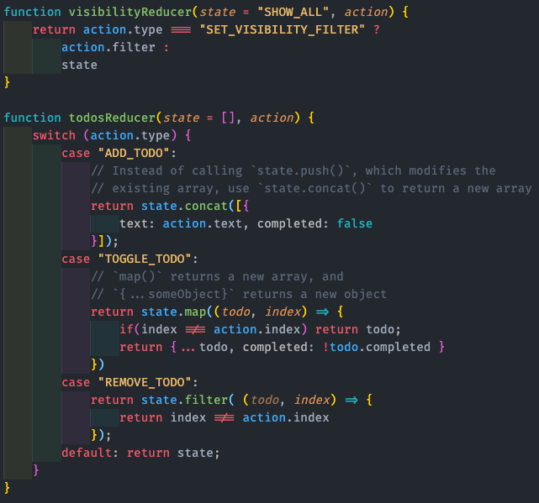
CORE CONCEPTS: REDUCERS
All state update logic lives in functions called reducers.
Since they're just functions, smaller functions can be composed together into larger functions.
Because reducer functions are simply (state, action) => newState, they are very easily testable and straightforward to understand.
Reducers should be pure functions, with no side effects.
That means they should only rely on inputs, and not affect anything external.
Reducers need to update data immutably, by making copies of state and modifying the copies before returning them, rather than directly modifying inputs.

Slide 12
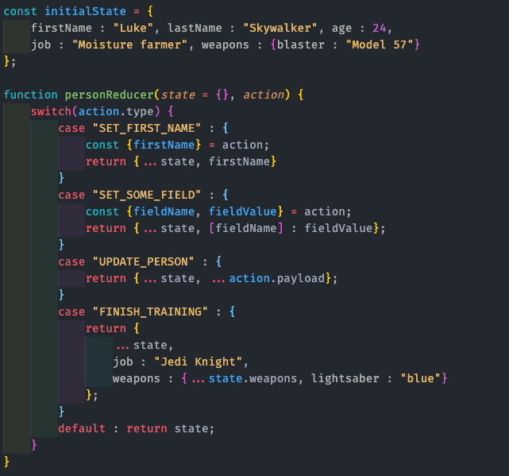
COMMON PATTERNS: UPDATING OBJECTS
Objects are normally copied using the object spread operator ( ... ).
Updating a nested field requires that all levels of nesting be copied too.

Slide 13
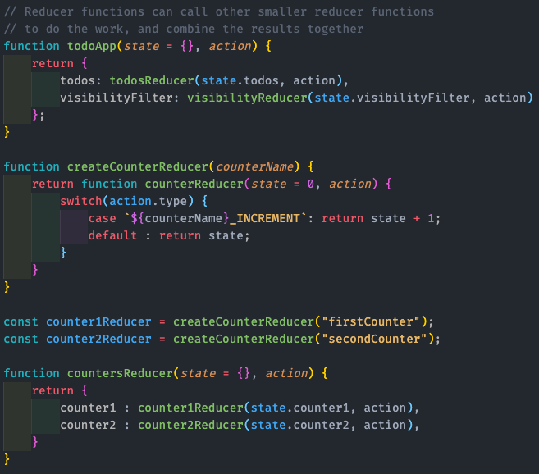
CORE CONCEPTS: COMBINING REDUCERS
Since reducers are just functions, they can call other functions to do some of the work.
It's normal to have a root reducer function that calls other reducers, splitting up the job of updating the Redux state object.
Higher-order reducers are a common technique for reusing reducer logic.
A higher-order reducer is a function that returns a new reducer function.

Slide 14
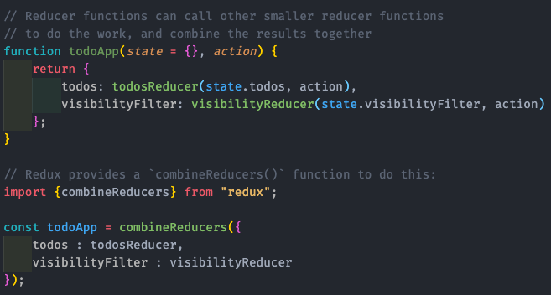
CORE CONCEPTS: COMBINING REDUCERS
The recommended pattern is to split reducer logic based on the slices of your state.
Because this is common, Redux provides a utility called combineReducers to make it easy to define which slice reducers are responsible for each slice of state.

Slide 15
USING combineReducers
Just a utility function for the most common use case, and doesn't handle every scenario.
You are not required to use it, and we encourage writing custom reducer logic if combineReducers doesn't do what you need.
It's opinionated, and enforces several rules for your slice reducers (cannot return undefined, should return initial state for an unknown action, etc)
Redux by itself only calls your root reducer function.
combineReducers is what calls "all your reducers", so that each slice reducer has a chance to respond to each action.
You can use it multiple times to set up multiple levels of reducer logic

Slide 16
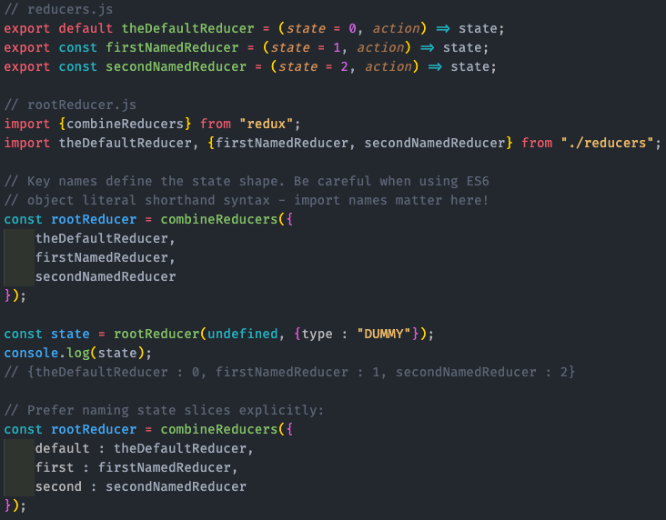
USING combineReducers
Takes an object where the key names define the slices of the state tree, and the values are reducer functions that are responsible for updating those slices
Slice reducers define their own initial state, usually using ES6 default function arguments.
Those are combined into an initial state tree when called with undefined.
Name your state slices after your data, not your reducer functions!
Watch out for accidentally "double-nesting" state slice names, like state.todos.todos

Slide 17
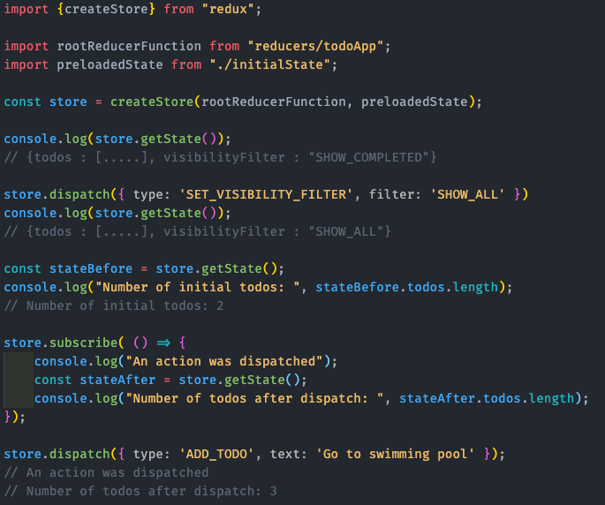
CORE CONCEPTS: STORE
A Redux store contains the current state value.
Stores are created using the createStore method, which takes the root reducer function and an optional preloaded state value.
Stores have three main methods:
getState: returns the current stored state value
dispatch: starts a state update with the provided action object
subscribe: accepts a callback function that will be run every time an action is dispatched

Slide 18
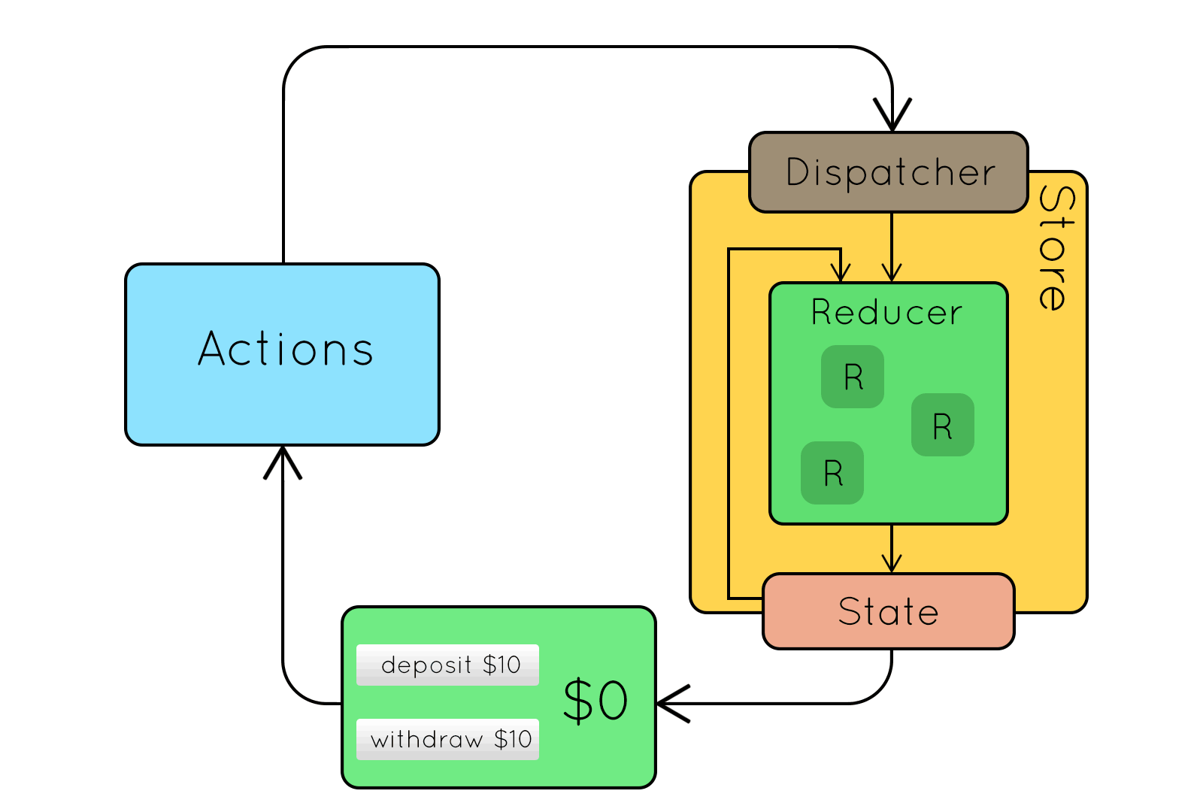
REDUX DATA FLOW
Redux features a uni-directional data flow, as opposed to ideas like "two-way data binding", or approaches where any model can be modified by any code at any time:
An action is dispatched (often in response to user interaction).
The root reducer function is called with the current state and the dispatched action.
That root reducer may delegate the work to other smaller reducer functions.
It then returns the new state.
The store notifies subscribers by running their callback functions.
Subscribers (usually UI components) can retrieve the updated state and re-render.

Slide 19
DEMO

Slide 20
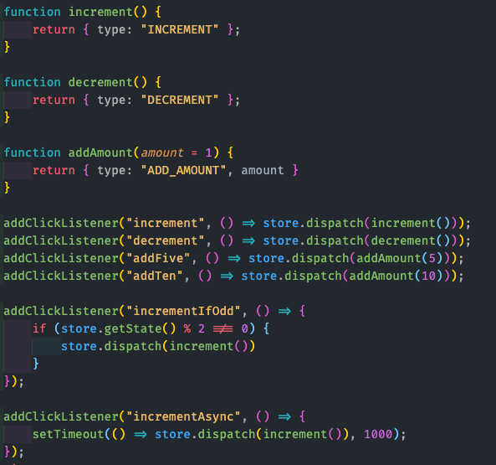
USING ACTION CREATORS
Action creator functions are used to encapsulate the process of creating action objects. This reduces duplication, and has benefits as applications get larger (especially when working with React).

Slide 21
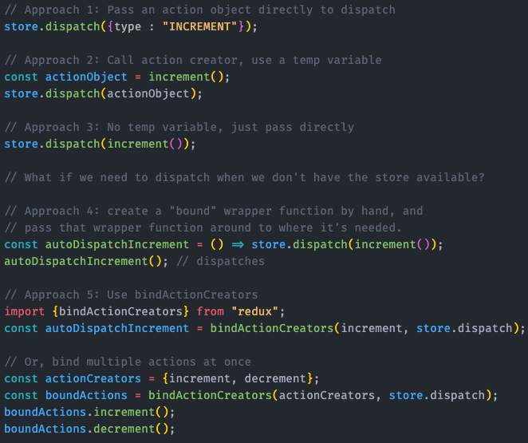
BINDING ACTION CREATORS
In a real application, we may want to dispatch actions from a place that doesn't have access to the store instance.
We can "bind" action creators by wrapping them to capture the store reference, and dispatch when the wrapper is called.
Redux provides a utility called bindActionCreators to do that wrapping for us automatically.

Slide 22
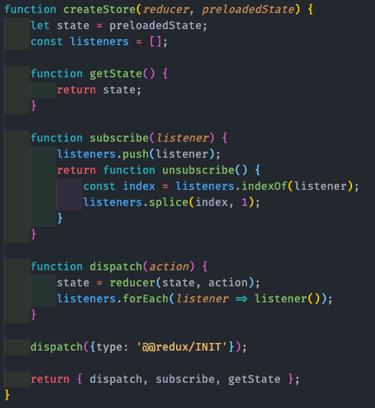
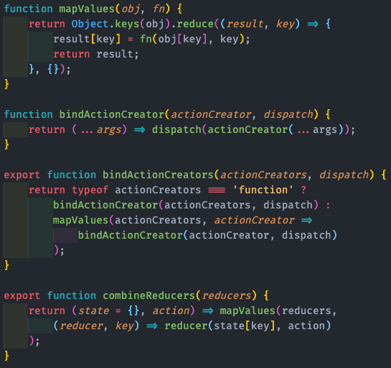
INSIDE A REDUX STORE (TINY IMPLEMENTATION)

Slide 24
REDUX WITH UI

Slide 25
WHY USE REDUX WITH REACT?
Since a React component can already store data in its internal state, why would you need to use Redux to manage that data instead?

Slide 26
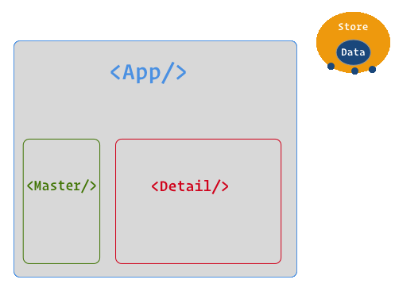
WHY USE REDUX WITH REACT?
If multiple components need to display the same data in different ways, storing the data outside the component tree makes it easier for each component to retrieve the data it needs, without having to pass it as props all the way down from top-level components.

Slide 27
WHY USE REDUX WITH REACT?
Modern JS build tools like Webpack have a capability called hot module reloading, which allows replacing pieces of your code as you make edits (without having to refresh the entire page).
If React components are swapped, they lose their internal state.
Keeping app state in Redux allows you to "live-edit" your components, while keeping all data intact.

Slide 28
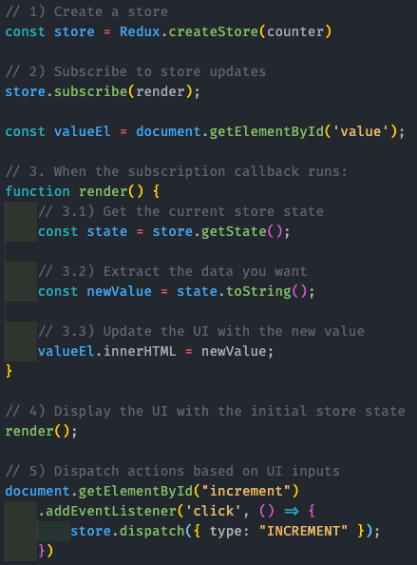
BASIC UI INTEGRATION
Using Redux with a UI requires a few consistent steps:
Create a Redux store
Subscribe to updates
Inside the subscription callback:
Get the current store state
Extract the data needed by this piece of UI
Update the UI with the data
If necessary, render the UI with initial state
Respond to UI inputs by dispatching Redux actions

Slide 29
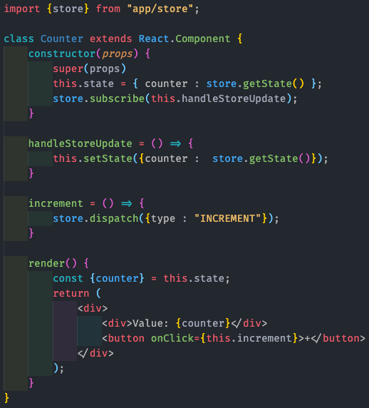
BASIC REACT INTEGRATION
Same example, using a React component (assume the store was created elsewhere in the app):
Import the redux store
Subscribe to updates
(better place it in componentDidMount() https://reactjs.org/docs/react-component.html#constructor)
Inside the subscription callback:
Get the current store state
Extract the data needed by this piece of UI
Update the UI with the data
If necessary, render the UI with initial state
Respond to UI inputs by dispatching Redux actions

Slide 30
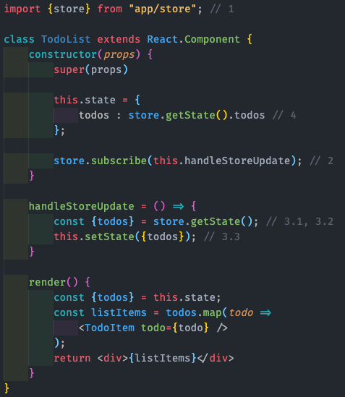
CONNECTING A TODO LIST
Similar approach for a Todo list:
Import the redux store
Subscribe to updates
Inside the subscription callback:
Get the current store state
Extract the data needed by this piece of UI
Update the UI with the data
If necessary, render the UI with initial state
Respond to UI inputs by dispatching Redux actions

Slide 31
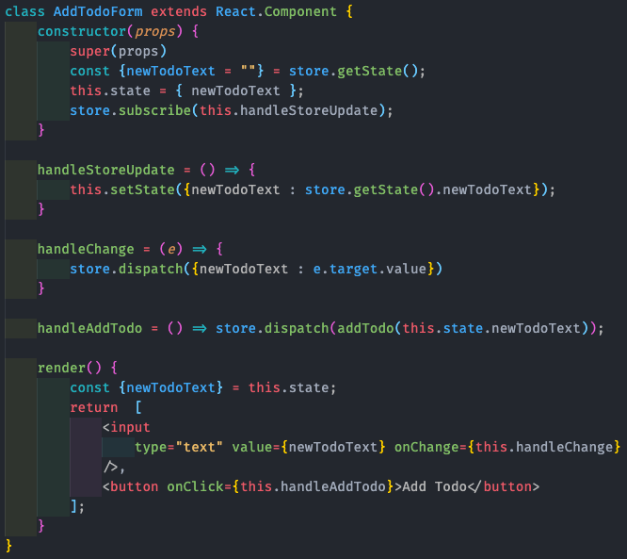
CONNECTING A FORM
Similar to the Todo list
We need to subscribe to the store so we can re-render, but now we also need to dispatch actions when the input changes or the "Add Todo" button is clicked.

Slide 32
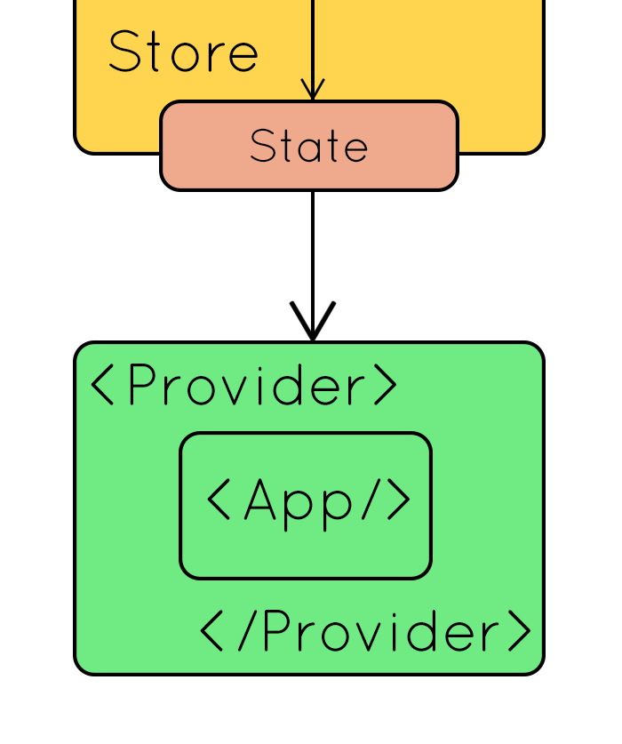
USING REDUX WITH REACT
Redux can be used with any UI layer (such as Angular, Vue, or plain JS), but is most commonly used with React.
The official React-Redux package provides bindings between React and Redux.
The connect function generates wrapper "container" components that subscribe to the store, so you don't have to write store subscription code for every component that needs to talk to the store.
Any component in your application can be wrapped with connect and "connected" to the store.
Connecting more components is usually better for performance.
Finally, putting a <Provider> component around your root component makes the store accessible to all connected components.

Slide 33
WHAT DOES CONNECT DO?
Automatically handles subscribing to the store, and helps dispatch actions
Performance optimizations - automatically implements shouldComponentUpdate, and only re-renders your component when the data it needs changes.
Separates "subscribing to the store" from "what store am I subscribing to, and where did it come from?"
Helps keep your React components "unaware" of Redux.

Slide 34
WHY USE REACT-REDUX?
There's no reason to write repetitive store subscription logic in every component.
connect handles that for you automatically.
connect does a lot of work to ensure your real component only re-renders when it actually needs to.
If you hand-write subscription code, your component will probably re-render too often.
Manually importing the store ties your components to that specific store instance, making it harder to test them.
React-Redux's <Provider> acts as a lightweight dependency injection approach, which lets you reuse Redux-connected components and test them with a fake store if needed.
Your components will receive data and callback functions as props, same as any other React component would.
This makes the more reusable.
Effectively all React+Redux apps use React-Redux, so that's what the documentation, articles, and community all refer to.

Slide 35
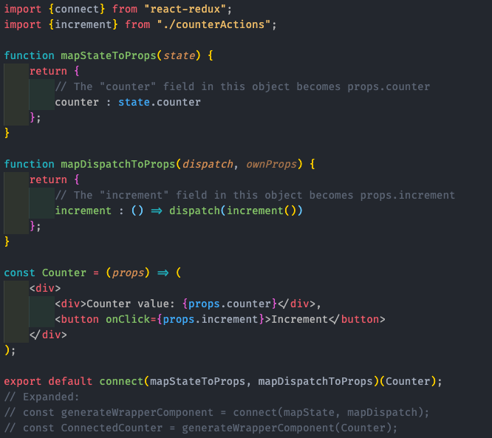
connect BASICS
The connect function takes two arguments, both optional:
mapStateToProps: called every time the store state changes.
It receives the entire store state, and should return an object of data this component needs.
mapDispatchToProps: called once on component creation.
It receives the dispatch method, and should return an object full of functions that use dispatch.
For both functions, each field in the returned object becomes a prop for the wrapped component.
connect returns a new function that accepts the component to wrap, and that function returns the wrapper component.

Slide 36
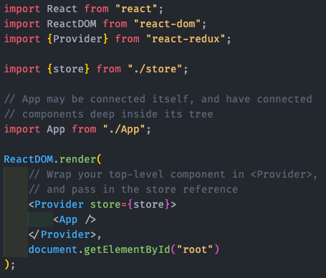
APP SETUP WITH Provider
Wrapping your root application component in <Provider> and passing it the store reference makes that store available to all connected components in the component tree.

Slide 37
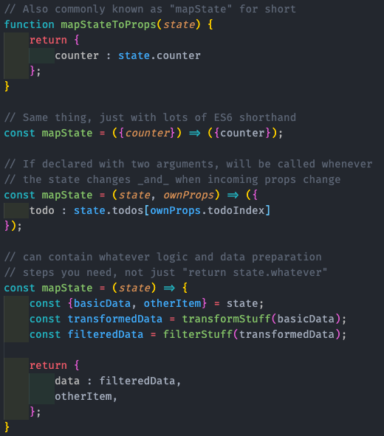
WRITING mapState FUNCTIONS
connect will re-run your mapState function every time the store state changes.
It does a shallow equality comparison between the last and current result objects, and re-renders your component if any fields are === different than the last result.
If your function is written with two parameters, it will get the wrapper component's props as the second argument, and it will also be called whenever the props passed to the wrapper component change.
Similar to reducers, a mapState function should be pure and have no side effects - just state ( + wrapper props) in, new component props out.

Slide 38
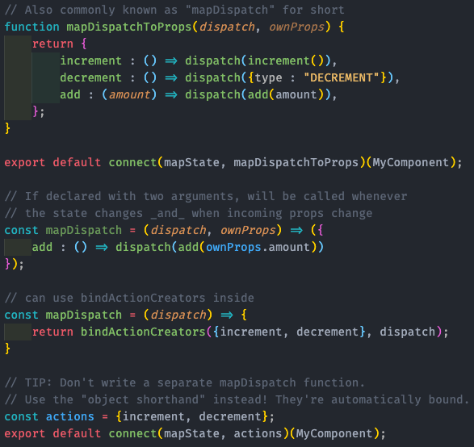
WRITING mapDispatch FUNCTIONS
By default, connect gives your components props.dispatch.
If you want to "bind" action creators instead, you can provide a mapDispatch function as the second argument to connect.
It gets dispatch as an argument, and you can return functions that will dispatch automatically when called.
Declaring mapDispatch with two arguments works the same way as mapState - will be given ownProps, and re-run when they change
Better choice: pass an object full of action creators as the second argument to connect (the "object shorthand")

Slide 39
TIPS FOR USING connect
You can connect as many of your app's components as you want, not just the root component.
In fact, connecting more components is usually better for performance!
Feel free to connect any component that needs to access store state or dispatch actions, or where passing props down multiple levels would be a pain.
Only declare your map* functions with two arguments if you really need to reference the props, otherwise it's a waste.
Both map* functions are optional.
If you only need data, use connect(mapState)(MyComponent).
If you only need to dispatch, use connect(null, mapDispatch)(MyComponent).
Tip: never write an actual mapDispatch function yourself - use the "object shorthand" form with action creators instead!

